Slide 1
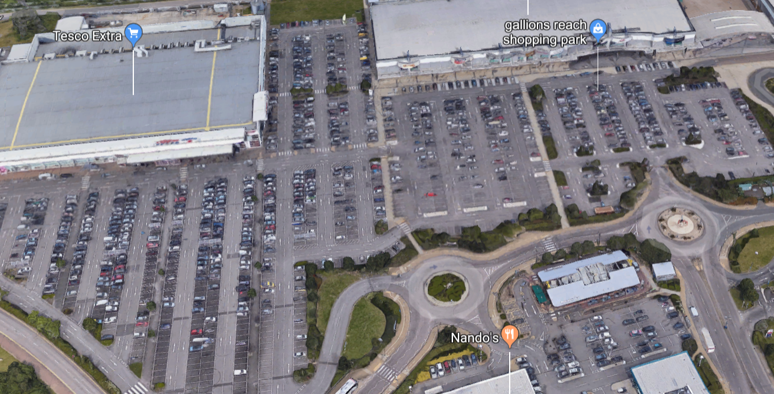
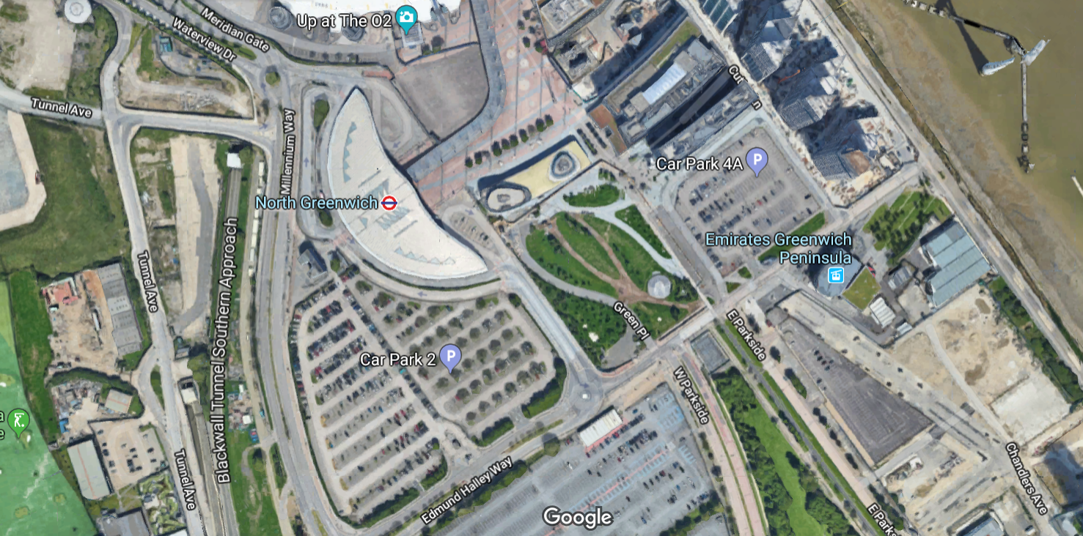
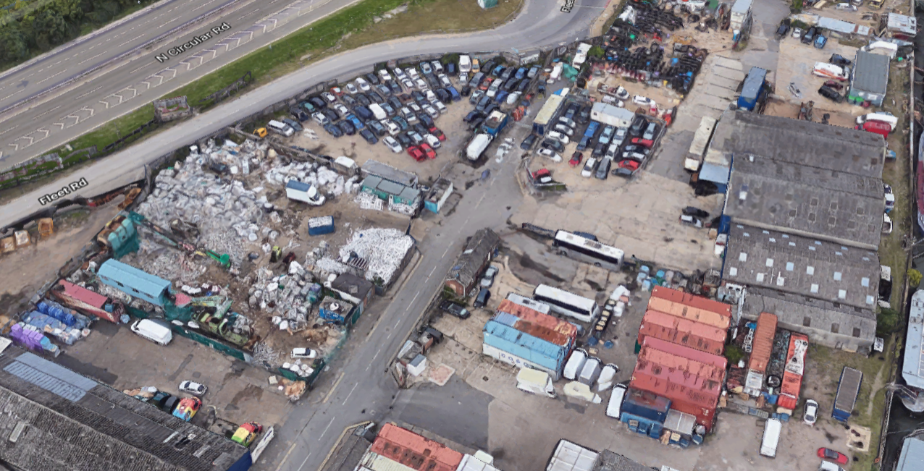

Slide 2
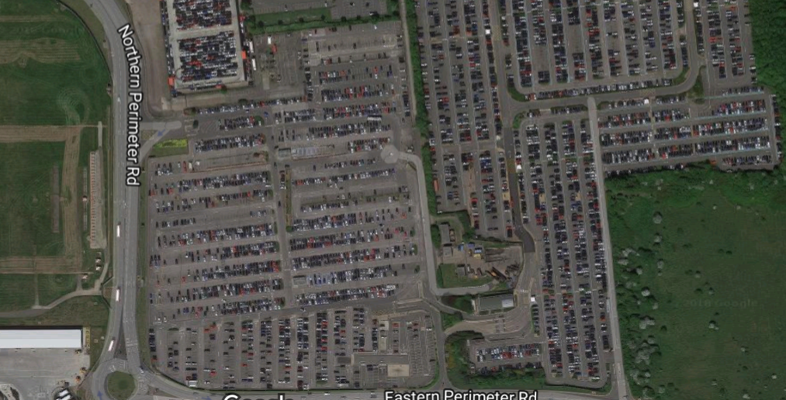
(a)
(b)
(c)
(d)

Slide 3
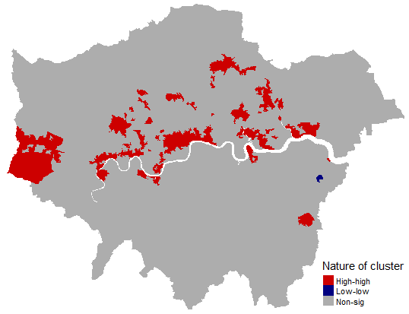
Chiswick, Acton
Heathrow
West London
Richmond
Hammersmith

Slide 4
Newham
Barking
Greenwich
East London

Slide 5
Southwest London
Chelsea, Kensington, Knightsbridge

Slide 6
Barbican, Moorgate
Central London

